Slide 1
Deep Learning from Scratch
Hyojin Lim

Slide 2
1. Multilayer Perceptron (MLP)
1.1 Training Data and Batching
The model was trained on MNIST data set that consists of 8,000 train sets and 2,000 test sets. Each training batch contains 100 image data in the size of 784 (28×28). 200 epochs are executed.
1.2 Optimizer
The base model used stochastic gradient descent (SGD) with ŋ=0.01.
1.3 Regularization
Three methods of regularization is employed in the variations of the base model:
Dropout Dropout is applied after the activation function of each layer.
L2 Regularization While the base model has no regularizations, the varied models are regularized with L2 norm of λ=0.1 or 0.01.
Batch Normalization Batch normalization is added before the activation layer and the dropout layer in the varied model.

Slide 3
 | h | d | opt | lr | w (L2) | train steps | train time (s) | test acc
base | 6 | 0.2 | SGD | 0.01 | 0 | 80 | 214.998 | 0.921
(A) | 8 |  |  |  |  |  | 265.679 | 0.915
 | 10 |  |  |  |  |  | 289.215 | 0.883
 | 12 |  |  |  |  |  | 333.743 | 0.643
(B) |  | 0.5 |  |  |  |  | 209.699 | 0.303
 |  | 0.8 |  |  |  |  | 210.114 | 0.117
(C) |  |  | Adam | 0.01 |  |  | 234.604 | 0.898
 |  |  |  | 0.001 |  |  | 227.640 | 0.936
 |  |  | RMSprop | 0.01 |  |  | 204.850 | 0.896
 |  |  |  | 0.001 |  |  | 213.574 | 0.947
(D) |  |  |  |  | 0.1 |  | 196.304 | 0.117
 |  |  |  |  | 0.01 |  | 205.551 | 0.908
(E) | use batch normalization |  |  |  |  |  | 260.922 | 0.930

Slide 4
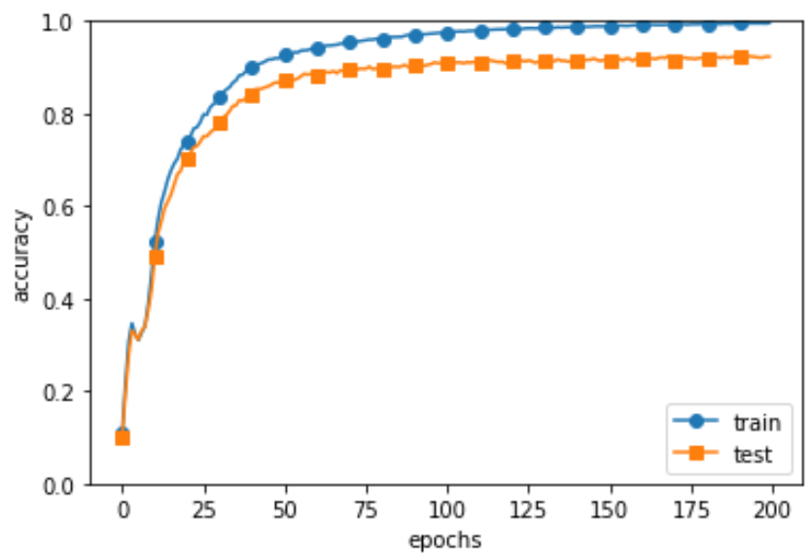
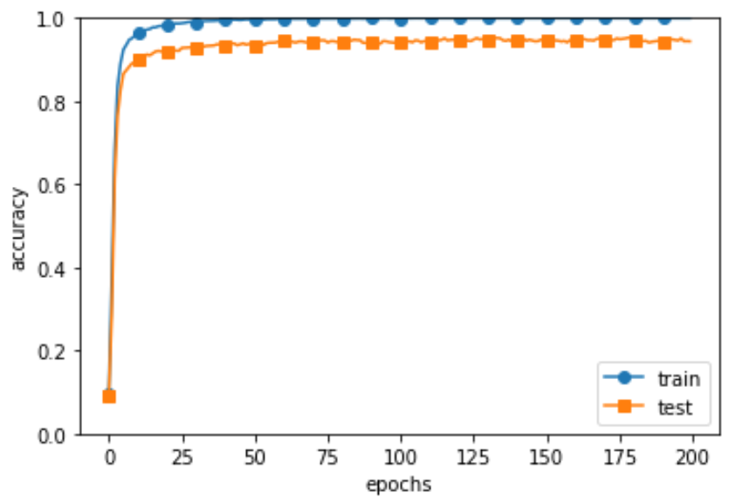
 | h | d | opt | lr | w (L2) | BN | train steps | train time (s) | test acc
base | 6 | 0.2 | SGD | 0.01 | 0 | False | 80 | 214.998 | 0.921
 | h | d | opt | lr | w (L2) | BN | train steps | train time (s) | test acc
tuned | 8 | 0.2 | Adam | 0.001 | 0 | True | 80 | 230.132 | 0.950

Slide 5
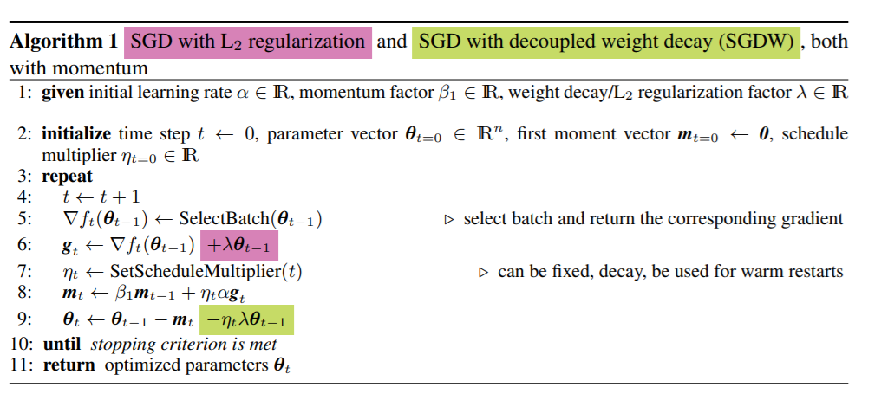
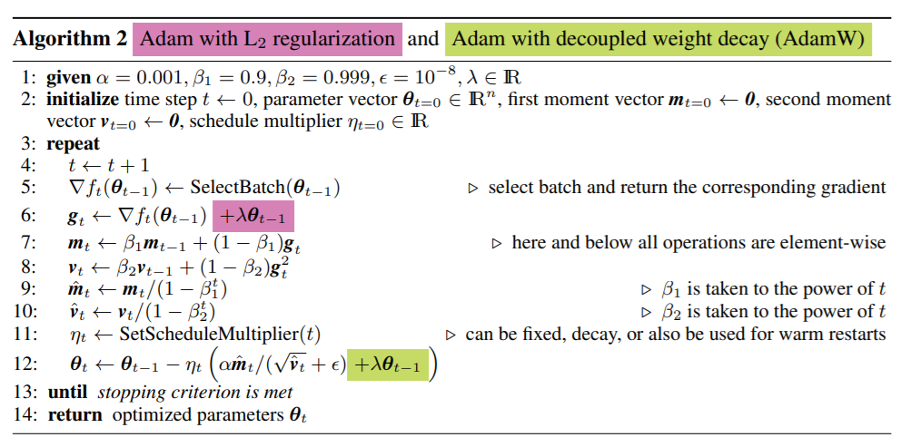
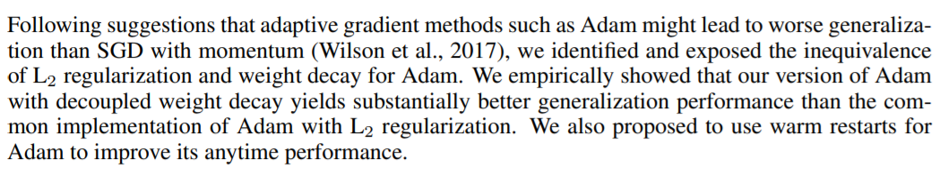
Loshchilov et al. “Decoupled Weight Decay Regularization”

Slide 6
2. Convolutional Neural Network (CNN)
2.1 Training Data and Batching
The model was trained on MNIST data set that consists of 800 train sets and 200 test sets. Each training batch contains 100 image data in the size of 784 (28×28). 10 epochs are executed.
2.2 Optimizer
The base model used Adam with ŋ=0.001.
2.3 Regularization
Dropout Dropout is applied after fully connected layers, one after the relu function and the other before the softmax function. Variation of the model contains dropout layers after pooling layers with different dropout ratio.

Slide 7
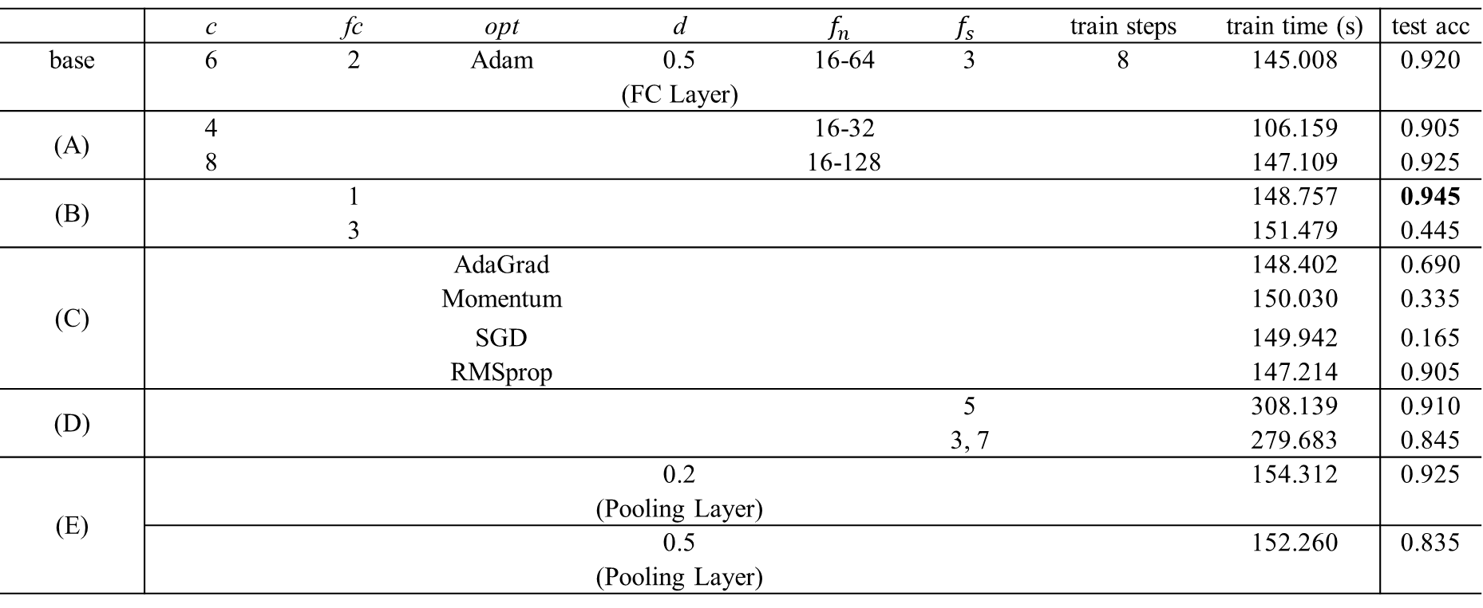
 | c | fc | opt | d | $$f_{n}$$ | $$f_{s}$$ | train steps | train time (s) | test acc
base | 6 | 2 | Adam | 0.5 (FC Layer) | 16-64 | 3 | 8 | 145.008 | 0.920
(A) | 4 |  |  |  | 16-32 |  |  | 106.159 | 0.905
 | 8 |  |  |  | 16-128 |  |  | 147.109 | 0.925
(B) |  | 1 |  |  |  |  |  | 148.757 | 0.945
 |  | 3 |  |  |  |  |  | 151.479 | 0.445
(C) |  |  | AdaGrad |  |  |  |  | 148.402 | 0.690
 |  |  | Momentum |  |  |  |  | 150.030 | 0.335
 |  |  | SGD |  |  |  |  | 149.942 | 0.165
 |  |  | RMSprop |  |  |  |  | 147.214 | 0.905
(D) |  |  |  |  |  | 5 |  | 308.139 | 0.910
 |  |  |  |  |  | 3, 7 |  | 279.683 | 0.845
(E) |  |  |  | 0.2 (Pooling Layer) |  |  |  | 154.312 | 0.925
 |  |  |  | 0.5 (Pooling Layer) |  |  |  | 152.260 | 0.835

Slide 8
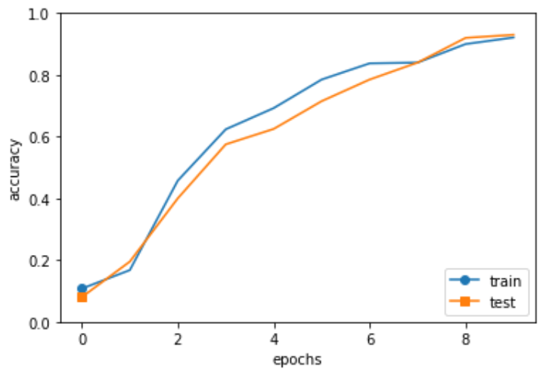
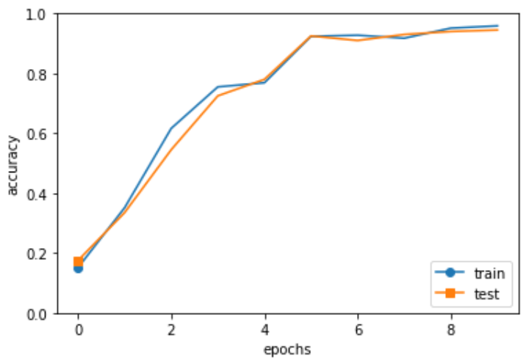
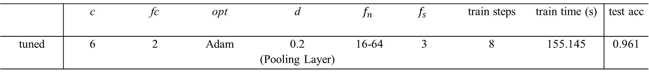
 | c | fc | opt | d | $$f_{n}$$ | $$f_{s}$$ | train steps | train time (s) | test acc
base | 6 | 2 | Adam | 0.5 (FC Layer) | 16-64 | 3 | 8 | 145.008 | 0.920
 | c | fc | opt | d | $$f_{n}$$ | $$f_{s}$$ | train steps | train time (s) | test acc
tuned | 6 | 2 | Adam | 0.2 (Pooling Layer) | 16-64 | 3 | 8 | 155.145 | 0.961

Slide 9
3. Recurrent Neural Network (RNN)
3.1 Training Data and Batching
The model was trained on PTB data set. The train corpus has a length of 300,000 while test corpus has 30,000. 4 epochs are executed with batch size of 100.
3.2 Optimizer
The base model used stochastic gradient descent (SGD) with ŋ=0.1.
3.3 Regularization
Dropout Dropout is applied after embedding layers and RNN layers in tuned models.

Slide 10
Table 3: Variations on the recurrent neural network language model architecture. Unlisted values are identical to those of the base model.
 | w | n | opt | lr | train steps | train time (s) | PPL
base | 100 | 2 (LSTM) | SGD | 0.1 | 3000 | 284.218 | 306.361
(A) | 150 |  |  |  |  | 369.906 | 376.547
 | 200 |  |  |  |  | 448.085 | 317.120
(B) |  | 1 (LSTM) |  |  |  | 327.892 | 324.012
 |  | 3 (LSTM) |  |  |  | 423.698 | 491.910
(C) |  |  | Adam | 0.01 |  | 289.722 | 223.103
 |  |  | Adam | 0.1 |  | 499.927 | 368.760
 |  |  | RMSprop | 0.01 |  | 292.042 | 208.837
(D) | use dropout and weight tying |  |  |  |  | 374.415 | 372.277

Slide 11
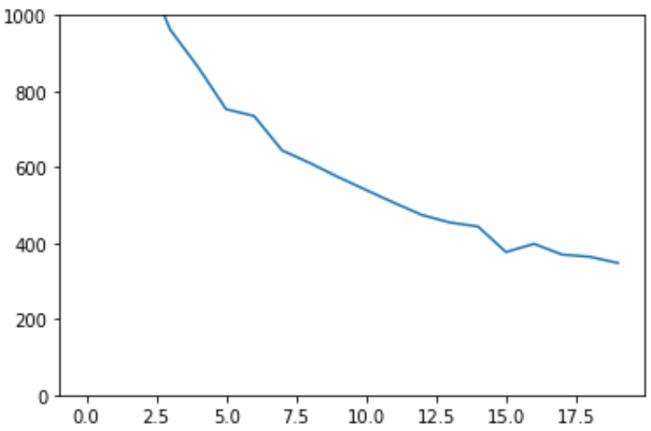
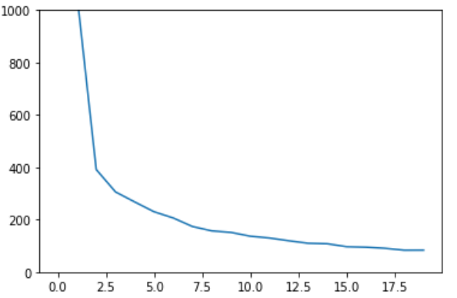
 | w | n | opt | lr | train steps | train time (s) | PPL
base | 100 | 2 (LSTM) | SGD | 0.1 | 3000 | 284.218 | 306.361
 | w | n | opt | lr | train steps | train time (s) | PPL
tuned | 100 | 1 (LSTM) | RMSprop | 0.01 | 3000 | 329.620 | 83.45

Slide 12
4. Sequence to Sequence (seq2seq)
4.1 Training Data and Batching
The model was trained on toy data set which is a text file of addition mathematical expressions. 10 epochs are executed with batch size of 128.
4.2 Optimizer
The base model used Adam with ŋ=0.001.
4.3 Attention
Variations of the base model use attention as a method of improvement.

Slide 13
Table 4: Variations on the sequence to sequence model architecture. Unlisted values are identical to those of the base model.
 | w | h | opt | lr | train steps | train time (s) | test acc
base | 16 | 128 | Adam | 0.001 | 350 | 283.559 | 0.054
(A) | 32 |  |  |  |  | 305.150 | 0.083
 | 64 |  |  |  |  | 359.227 | 0.061
(B) |  | 64 |  |  |  | 184.159 | 0.046
 |  | 256 |  |  |  | 649.484 | 0.278
(C) |  |  | Adam | 0.01 |  | 300.782 | 0.171
 |  |  | SGD | 0.01 |  | 274.654 | 0.002
 |  |  | RMSprop | 0.01 |  | 280.766 | 0.102
(D) | reverse input data sequence |  |  |  |  | 299.857 | 0.298
(E) | concatenate encoder hidden state to every time step of the decoder |  |  |  |  | 324.455 | 0.188
(F) | use attention |  |  |  |  | 335.039 | 0.068

Slide 14
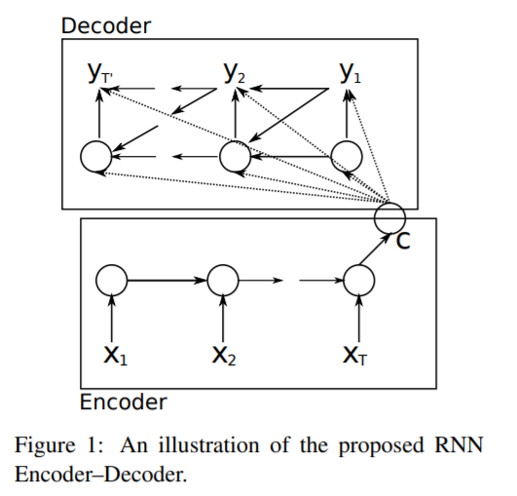
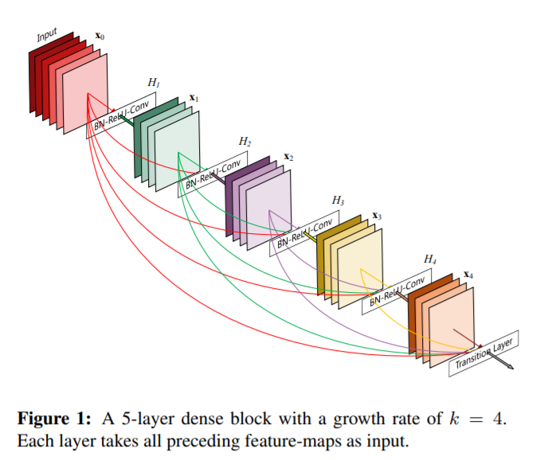
Gao Huang et al. “Densely Connected Convolutional Networks”
Kyunghyun Cho et al. “Learning Phrase Representations using RNN Encoder–Decoder for Statistical Machine Translation”

Slide 15
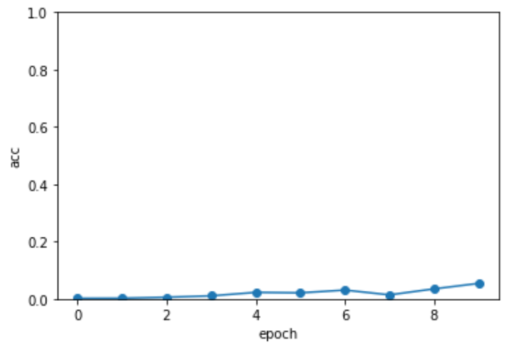
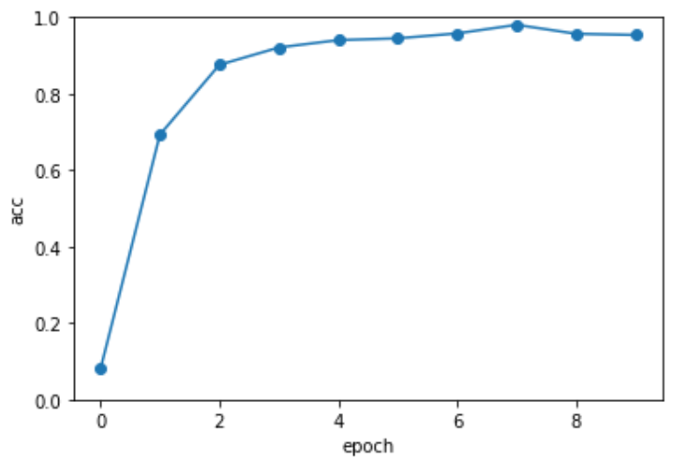
 | w | h | opt | lr | train steps | train time (s) | test acc
base | 16 | 128 | Adam | 0.001 | 350 | 283.559 | 0.054
 | w | h | opt | lr | train steps | train time (s) | test acc
tuned +reverse input +attention | 32 | 256 | Adam | 0.01 | 350 | 740.399 | 0.953

